Slide 1

Bacchus Winery
Brendan Bard, Phillip Dec, and Pao Vang

Slide 2
Bacchus Winery Case Study
Stan and Davis Bacchus inherited their father's winery business and want to improve it by incorporating new business methods. The winery grows grapes for four types of wine and sources their supplies from different suppliers. Stan and Davis want to find a more efficient method of tracking supply inventory, ordering supplies, and enabling distributors to order online and track shipments. Additionally, they want information on supplier delivery times, wine sales performance, and employee work hours to prepare for their yearly business review.

Slide 3
Questions to consider:
Are all supplies delivering on time? Is there a large gap between expected delivery and actual delivery?
The wine distribution, are all wines selling as they thought? Is one wine not selling? Which distributor carries which wine?
Employee time. During the last four quarters, how many hours did each employee work?

Slide 4
Business Rules
An employee can only be employed for one role, but a role can belong to multiple employees
An employee can have multiple paychecks, but each paycheck only belongs to one employee
An employee can order many supplies, but a supply order can only be done by one employee
Ship date cannot be prior to order date for any given order
A wine can be park of multiple orders
A supplier can have many deliveries
Customer can place multiple orders
Each supply shipment is linked to one order and vice versa

Slide 5
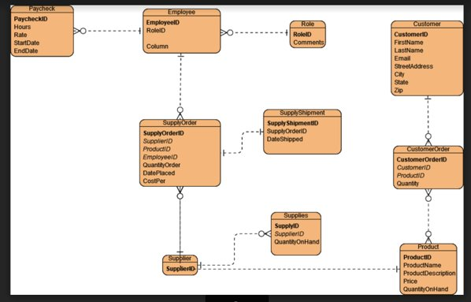
ERD

Slide 6
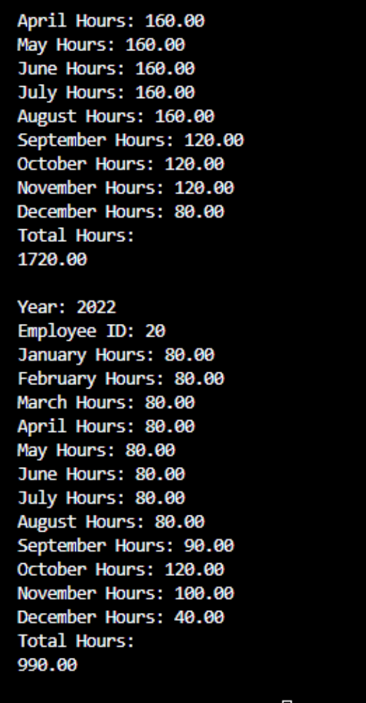
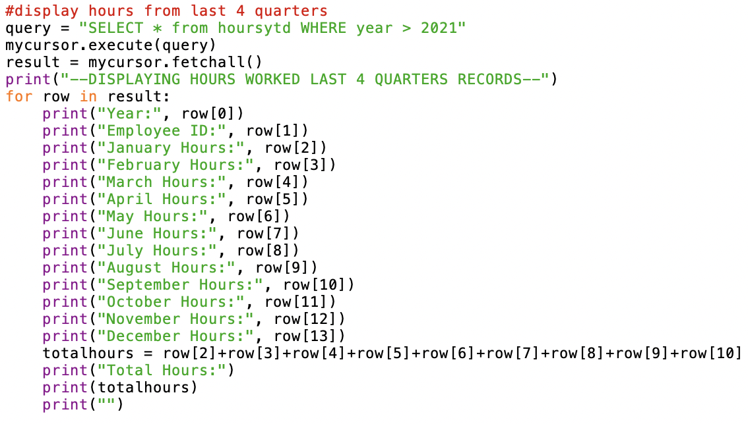
Report 1
Results:
To determine employee time, we generated a summary of hours worked for the last 4 quarters for each employee.
Python script:

Slide 7
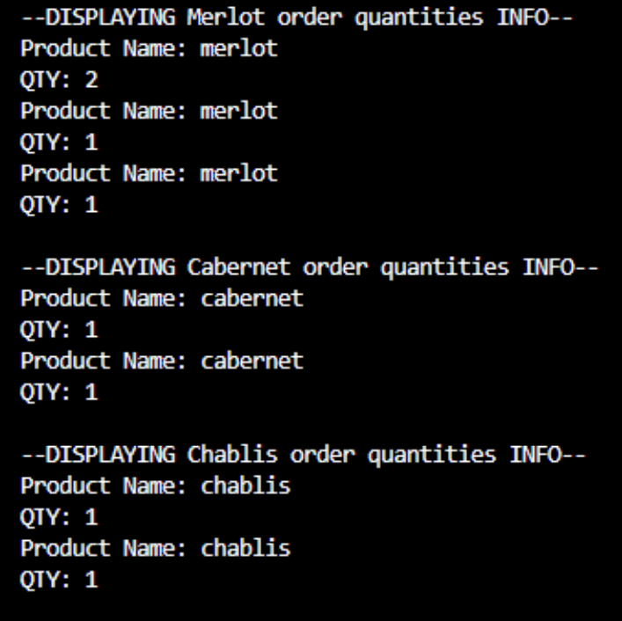
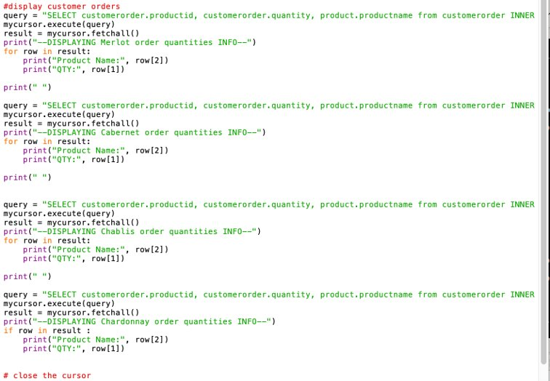
Report 2
Results:
Report 2 is a summary of the quantity of products ordered by customers. This helps determine if the wines are selling as Stan and Davis thought.
Python script:

Slide 8
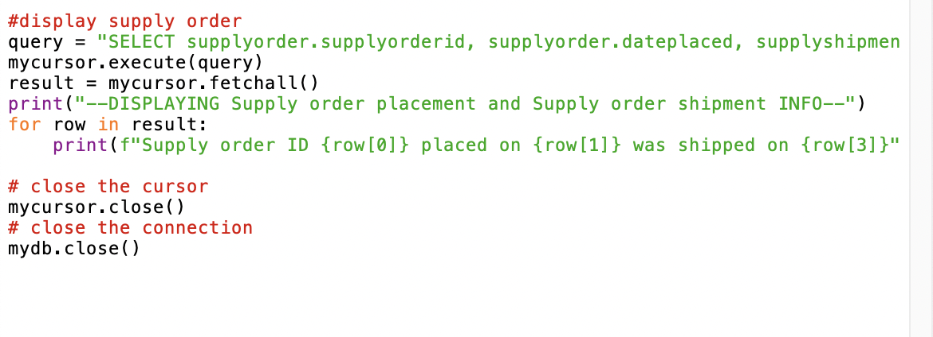
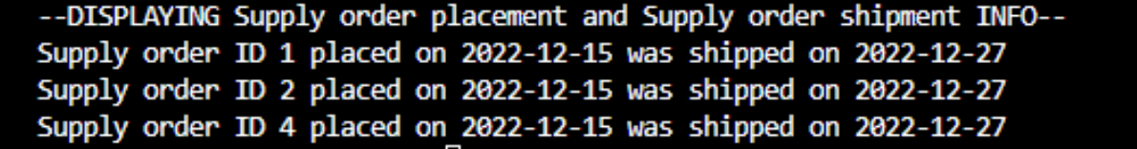
Report 3
Python script:
Report 3 is summary of supply order date placed and date shipped. The gap between order placement date and order shipment date is 12 days, which is pretty significant gap.
Results:

